Slide 1
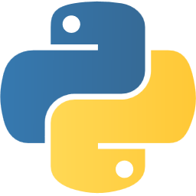
Introduction to Python

Slide 2

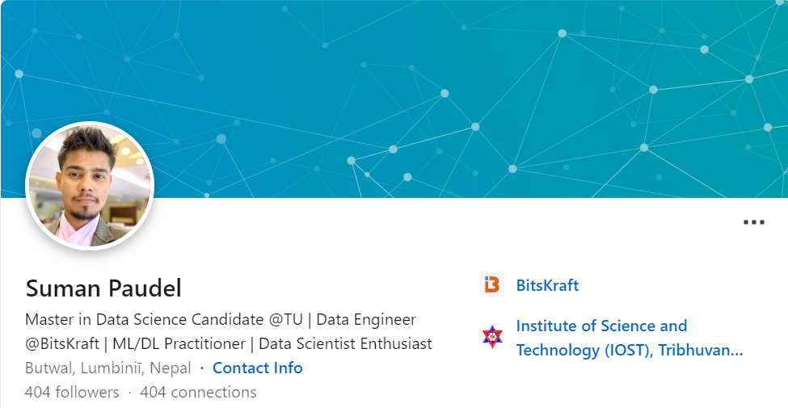
About Me
Data Scientist/Engineer at BitsKraft
Around 3 years of industry experience
Graduated Computer Engineering (2021)

Slide 3
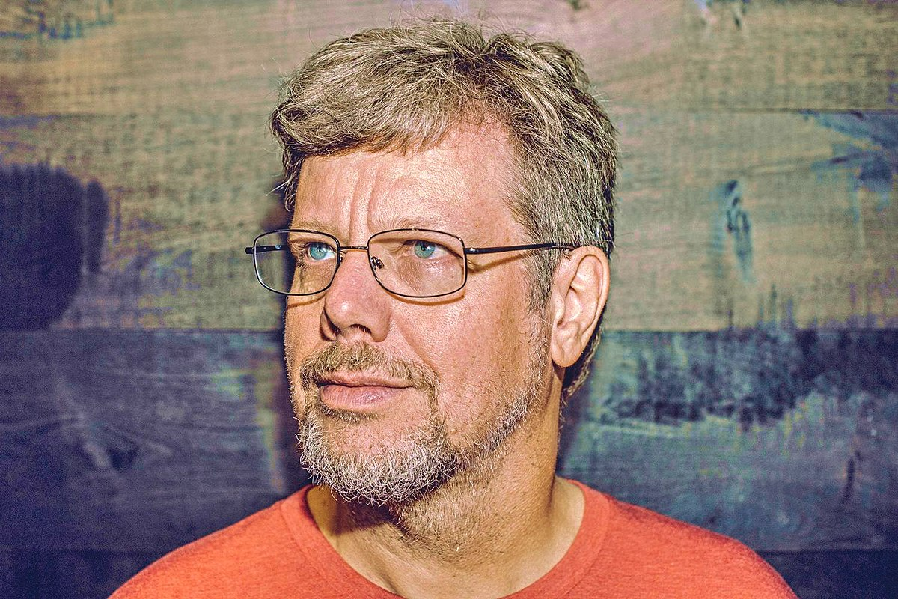
Python
created by Guido van Rossum at 1991.
Easy to learn and powerful programming language.
General purpose programming language with wide range of applications including web development, data analysis, artificial intelligence, scientific computing, and more.
https://www.python.org/

Slide 4
Features of Python
Free and Open Source
Beginner Friendly and easy learning curve6
Easy to Use, Code, Read and Debug
Dynamically Typed and Interpreted Language
Object Oriented Programming Capabilities
Extensive Range of Library and Frameworks
Versatility –wide range of applications.
Strong Community Support and many more…

Slide 7
TIP OF THE DAY
Swapping
In python you can use swapping in one line.
a = 5
b = 4
a, b = b, a

